Slide 1

RNS Institute of Technology
(AICTE Approved, VTU Affiliated and NAAC ‘A’ Accredited)
Department of Information Science and Engineering
(Accredited by NBA for the Academic Years 2018-19, 2019-20 and 2020-21)
Data structures Laboratory-18CSL38
Carried out by
Rohith kumar HK (1RN19IS122)
Rushwanth K (1RN19IS123)
Rutvick Sreedhar (1RN19IS124)
Staff in Charge: Mrs. Vinutha G K
Designation: Assistant Professor

Slide 2
Abstract
Introduction
Objective of the project
Data Structure
System requirements
Project Architecture
Implementation modules
Results
Conclusion & Future Enhancements
References
Department of ISE,RNSIT

Slide 3
The purpose of this mini project is in fulfillment of the requirements of customer using the bank for payment. The programing language used to develop the project is C. The data structure used is doubly linked list.
The domain “Banking System” keeps the day to day Tally record as a complete Banking. It can keep the information of Account opening, Deposit, Withdraw and display the transaction report, Individual account opening and editing details. The exciting part of this project is it displays transaction reports, Statistical summary of all accounts.
Department of ISE,RNSIT

Slide 4
This program will be provided as toll to the bank. The bank has been working for account information, withdrawal (through cash/cheque) and deposit amount. In this program you can keep record for daily banking transactions.
The objective is to prepare the program that can maintain data and provide a user friendly interface for retrieving customer related details just in few seconds, so it is not time consuming process. No paper work required and can be implemented further.
The program should also facilitate the addition of new customer account , deletion of account and modification of existing customer account and show all.
Department of ISE,RNSIT

Slide 5
The objective and goals of the proposed program are:-
To allow only authorized user to access various function. Reduced clerical work as most of the work is done by computer, provide greater speed and reduced time consumption to increase the number of account and customer.
This program will reduce the manual workload and give information instantly, the program will maintain the list of account and customer record and balance status. The program will be user friendly so that even a beginner can operate it and thus maintain the status of account balance easily.
Department of ISE,RNSIT

Slide 6
DOUBLY LINKED LIST:
Doubly linked list contains a link element called first and last
Each link carry a data fields and a link field called next.
Each link is linked with its next-link using its next link.
Each link is linked with previous link using its previous link.
Last link carries a link as null to mark the end of list.
BASIC OPERATION:
Insertion- add an element at the beginning of the list
Deletion- delete an element at the beginning of the list
Insert last– add an element in the end of the list
Delete last- delete an element from the end of the list
Insert after- add an element after an item of the list
Update- to update/edit a node
Traversal- to traverse all the nodes one after another.
Department of ISE,RNSIT

Slide 7
System Requirements
Code blocks or any other c platforms.
Windows XP or higher OS.
Online GDB can also be used
Hardware
PROCESSOR – Intel core 2 Duo (1.6GHZ) or higher version.
RAM - 2GB or more.
HARD DISK – 1GB of free hard disk.
GRAPHICS – Not applicable.
Department of ISE,RNSIT

Slide 8
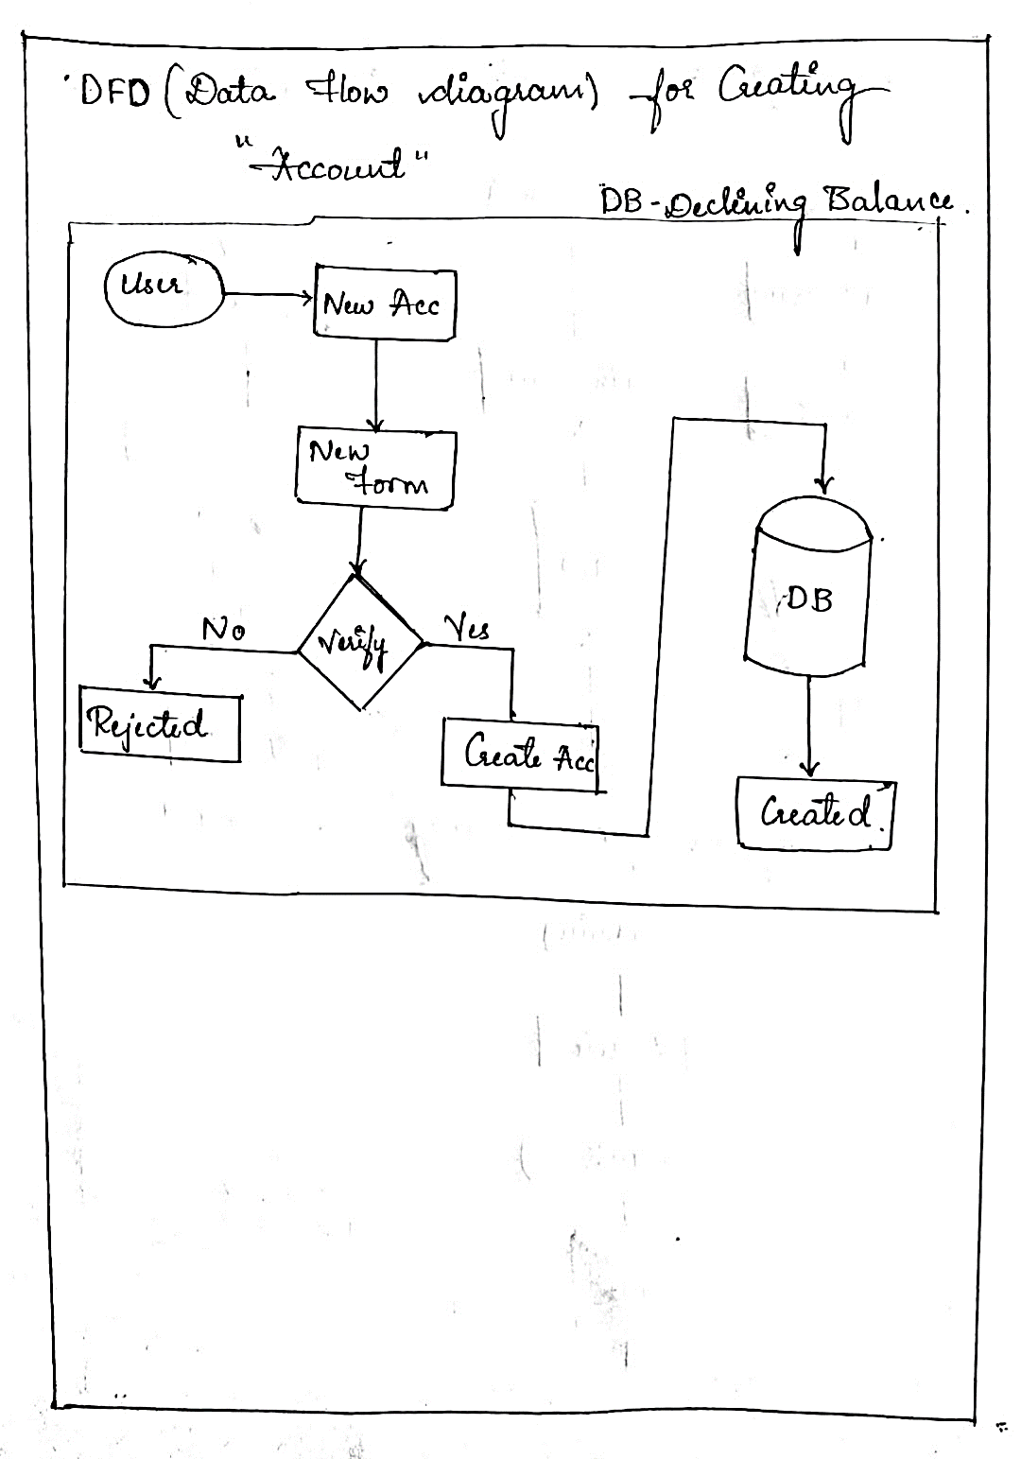
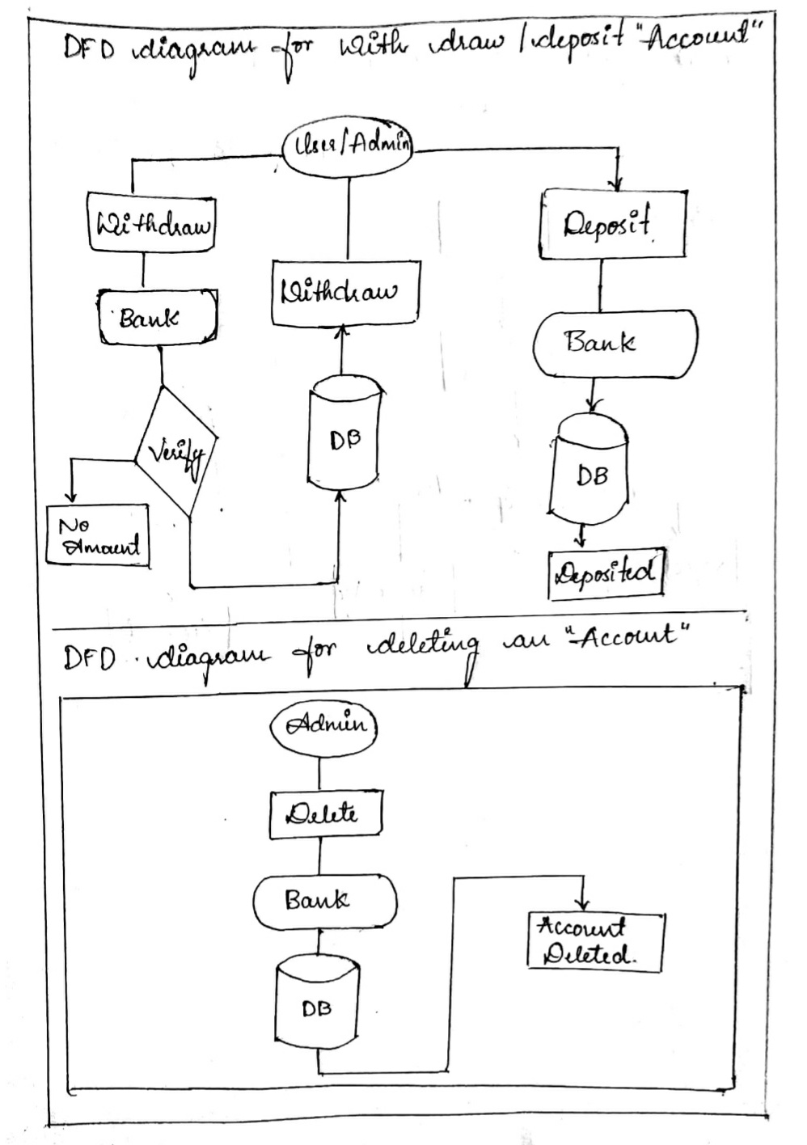
Department of ISE,RNSIT

Slide 9
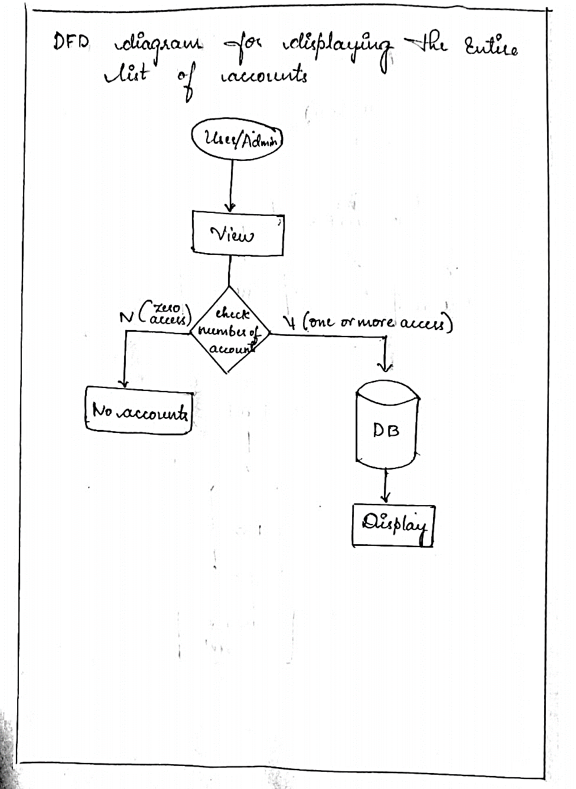
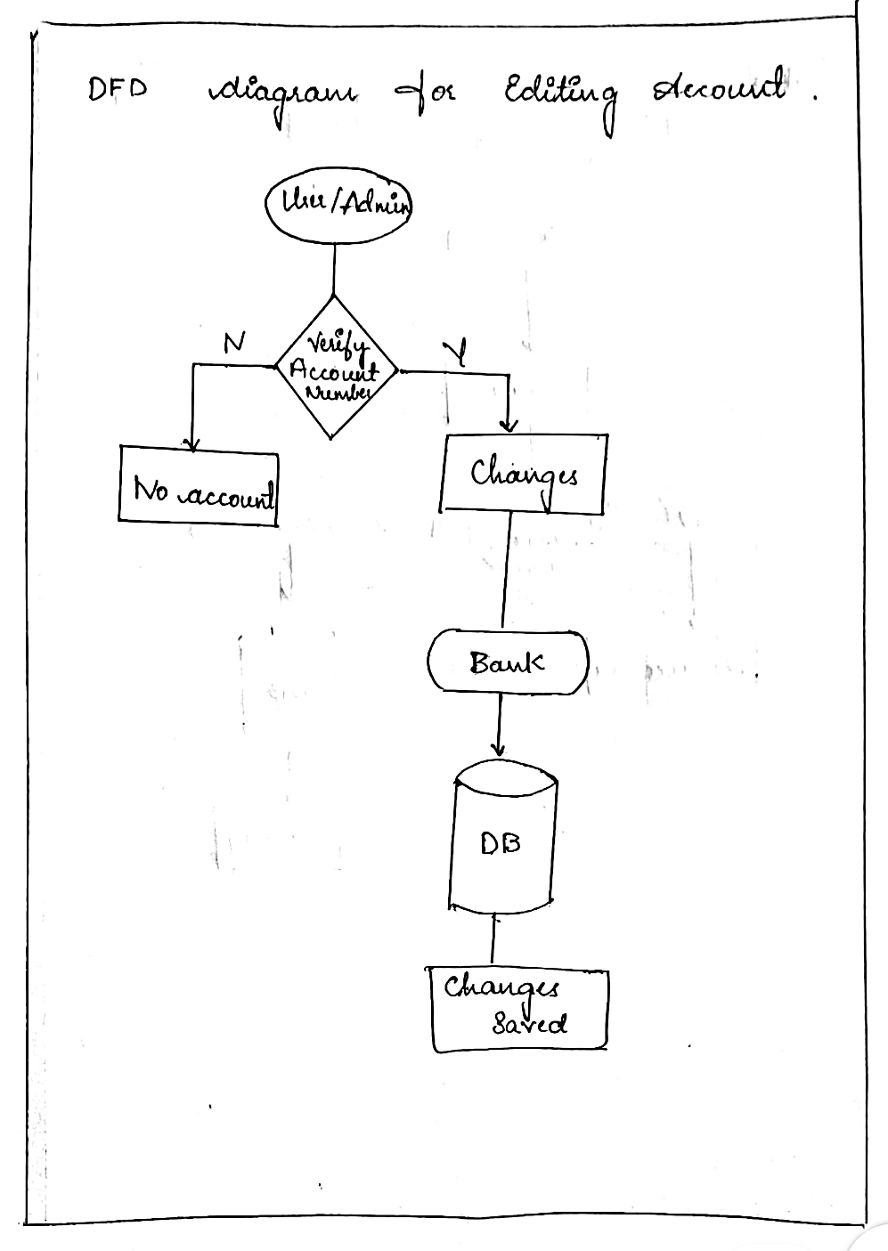
Department of ISE,RNSIT

Slide 10
Node (structure)
Variables declared:
Char types:
fname(first name)
lname(last name)
acc_no(account number)
address
citizenship (aadhar number)
phone(mobile number)
Int types:
Age
Float types:
Amt(amount/balance)
Department of ISE,RNSIT

Slide 11
Pointer variables:
First(head)
Last(tail)
Temp(pointer1)
Temp1(pointer2)
Prev
Next
Functions:
1] create()
Step1: input account number (8digits).
Step2: verify whether its 8 digits and no alphabets in between and store it.
Step3: input first name and last name, age, address and store it.
Step4: input aadhar number (12 digits).
Step5: verify whether its 12digits and no alphabets and store it.
Step6: input phone number(10 digits).
Step7: verify whether its 10 digits and no alphabets and store it.
Step8: input amount to deposit.
Step9: return.
Department of ISE,RNSIT

Slide 12
2] insert at first()
Step1: calls create() function and input values.
Step2: if first == NULL
Then
first=temp
last=first
else
first-> prev= temp
Temp->next=first
First=temp
Step4: return.
3] display()
Step1: if first == NULL
Then
Print no accounts.
Else
While(temp!= NULL)
Print the list of accounts.
Department of ISE,RNSIT

Slide 13
temp= temp->next
End while.
Step2: return.
4] edit()
Step1: input account number to edit.
Step2: verify account number for existence.
True-> goto step3 to 6.
False-> print ‘no accounts’ return.
Step3: print options { 1. to edit name
2. To edit age
3. To edit address
4. To edit phone number
5. To edit aadhar number}
Step4: input choice.
Step5: input values to be changed.
Step6: verify input then value are changed and saved.
Step7: return.
Department of ISE,RNSIT

Slide 14
5] depositamt()
Step1: input account number
Step2: verify account number
If it exits then
Goto step3
Else print ‘account number does not exist’
Return.
Step3: print ‘account details and balance’.
Step4: input amount to deposit.
Step5: balance updated.
Step6: print ‘account details and new balance’.
Step7: return.
6] withdrawamt()
Step1: input account number.
Step2: verify account number
If it exits then
Goto step3
Else
Department of ISE,RNSIT

Slide 15
Print ‘account number does not exit’
Return.
Step3: print ‘account details and balance’.
Step4: input amount to withdraw
Step5: if amount > balance
Print ‘insufficient balance …. Retry’
Goto step4
Else
Balance = balance – withdraw
Step6: print account details and new balance.
Step7: return.
7] delaccfront()
Step1: if first == NULL
Print ‘no account to delete’.
Return.
Step2: if temp-> next == NULL
Print account details that is deleted.
Free(temp)
Department of ISE,RNSIT

Slide 16
First= null
Else
First=temp->next
Print account details that is deleted.
Free(temp)
First->prev= NULL.
Step3: return.
8] delaccend()
Step1: if first == NULL
Print ‘no of account to delete’
Return.
Step2: if temp->next == NULL
Print account details that is deleted.
Free (last)
Last= temp1
Last-> next = NULL
Step3: return
Department of ISE,RNSIT

Slide 17
9] delacc()
Step1: if first == NULL
Print ‘no of account is delete’
Return
Step2: if temp-> next == NULL
Print account details to be deleted
Free (temp)
First = NULL
Return.
Step3: input account number is deleted
Step4: verify account number
True-> goto step5
False-> print ‘account dose not exist’
Return.
Step5: while(temp!= NULL)
If (temp ->prev== NULL)
Calls delaccfront()
Break;
Department of ISE,RNSIT

Slide 18
Else
Print account details to be deleted.
Tmp-> prev-> next= temp->next
Temp-> next-> prev= tenp-> prev
Free(temp
Break;
Temp= temp-> next
End while.
Step6: return.
10] main()
Step1: print menu
Step2: print choices { 1.create number of new account
2. Add another account
3. View accounts list
4. Edit account
5. Deposit amount
6. Withdraw amount
7. Delete account
8. Exit}
Department of ISE,RNSIT

Slide 19
Step3: input choice
Step4: while(1)
Step5: switch(choice)
case 1: input value of n
for i=0 to i<n
call insertatfirst()
i++
end for
break;
case 2: insertatfirst()
break
case 3: display()
break
case 4: edit()
break
case 5: depositamt()
break
case 6: withdrawamt()
break
case 7: delacc()
break
Department of ISE,RNSIT

Slide 20
case 8: exit(1)
default: print ‘Incorrect choice’
end while
Step6: End.
Department of ISE,RNSIT

Slide 21
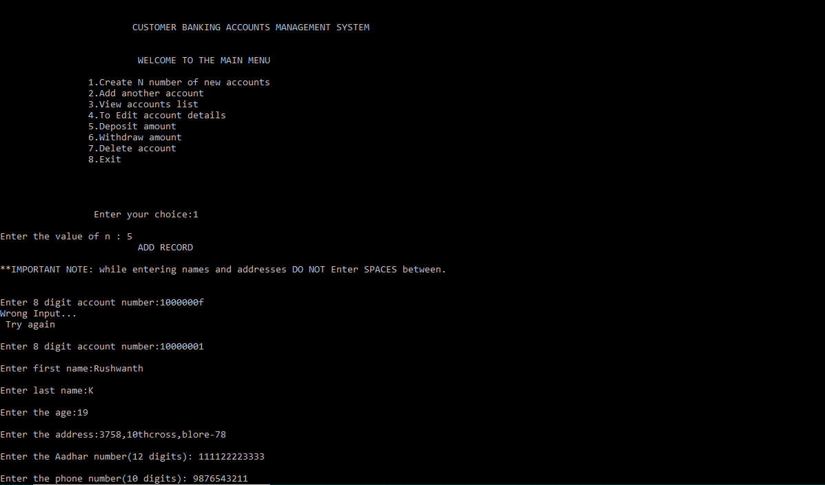
Department of ISE,RNSIT

Slide 22
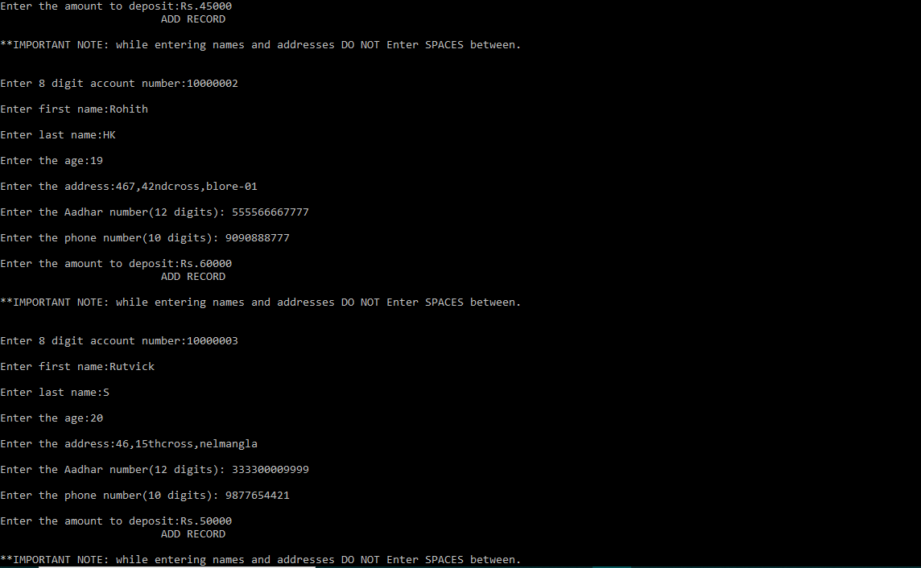
Department of ISE,RNSIT

Slide 23
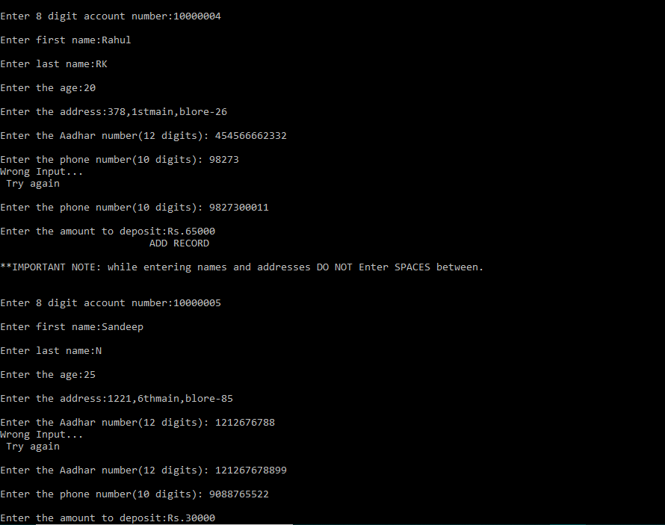
Department of ISE,RNSIT

Slide 24
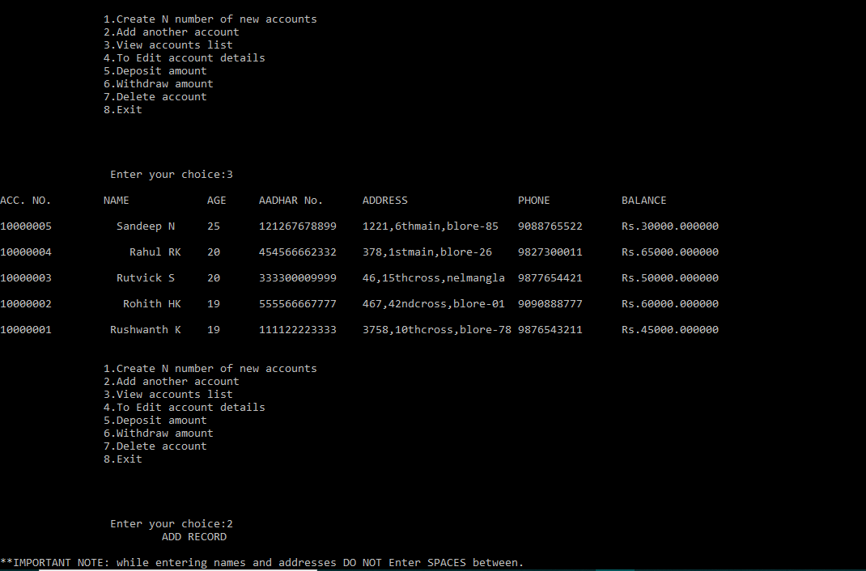
Department of ISE,RNSIT

Slide 25
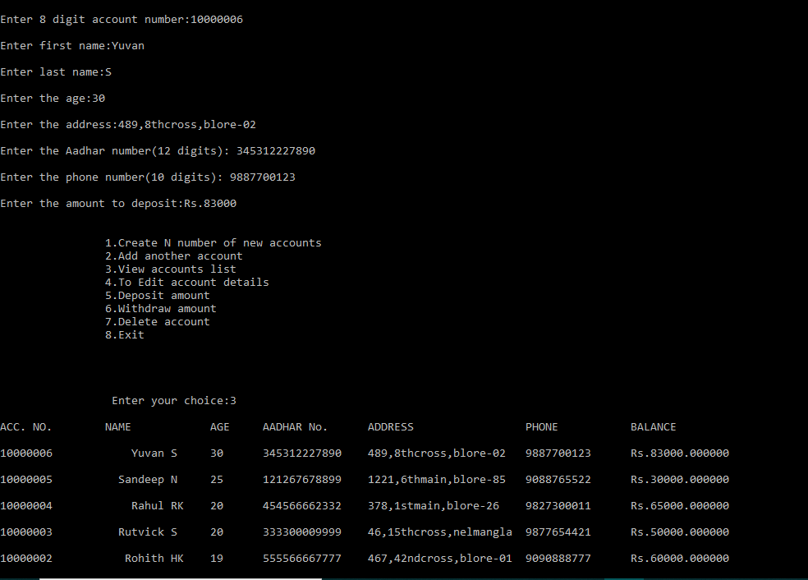
Department of ISE,RNSIT

Slide 26
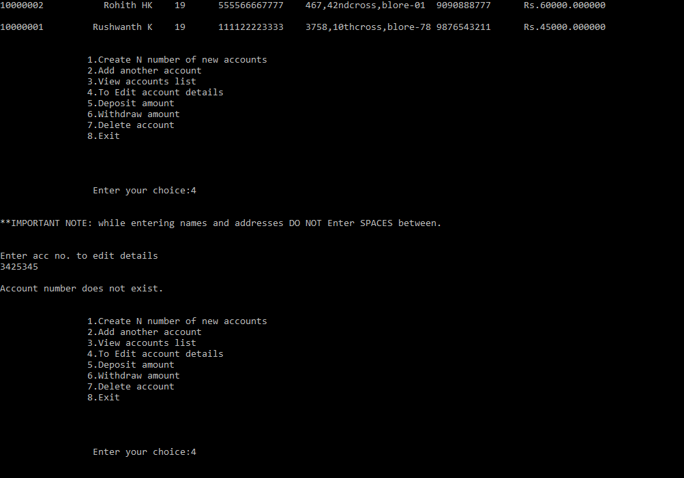
Department of ISE,RNSIT

Slide 27
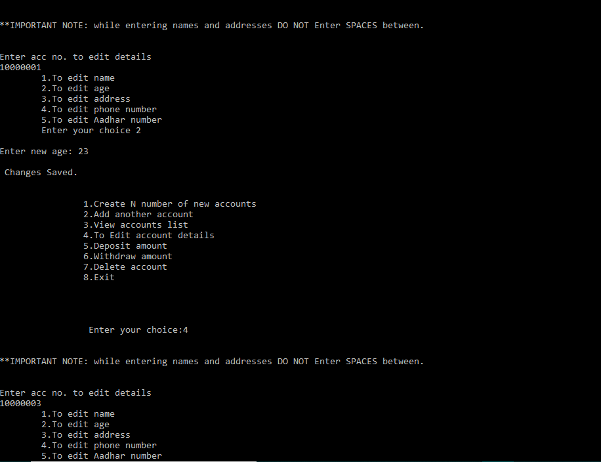
Department of ISE,RNSIT

Slide 28
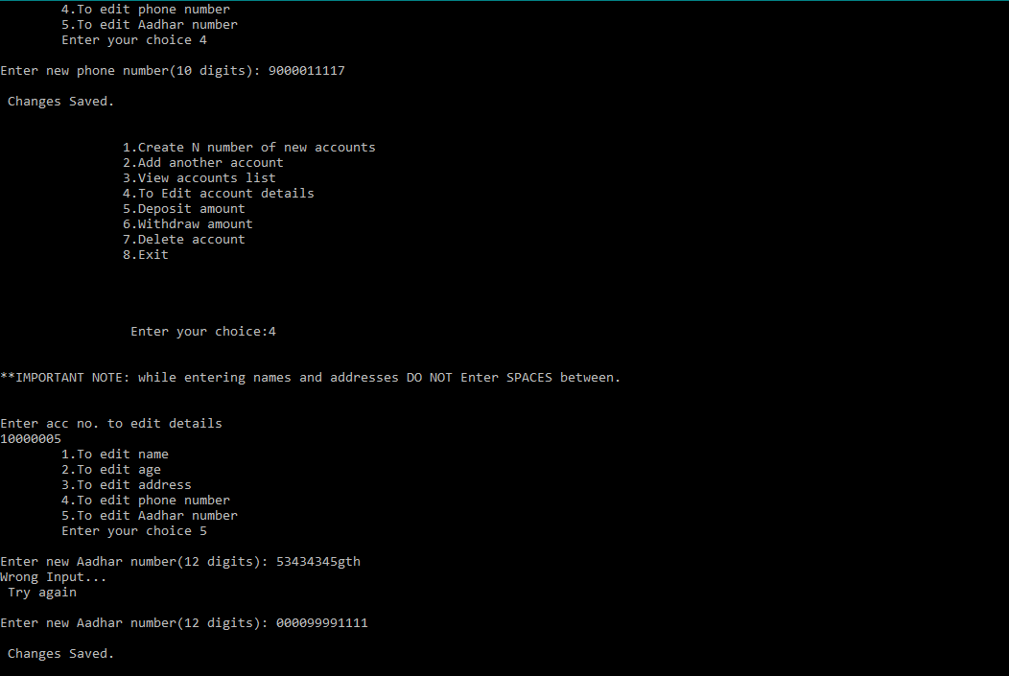
Department of ISE,RNSIT

Slide 29
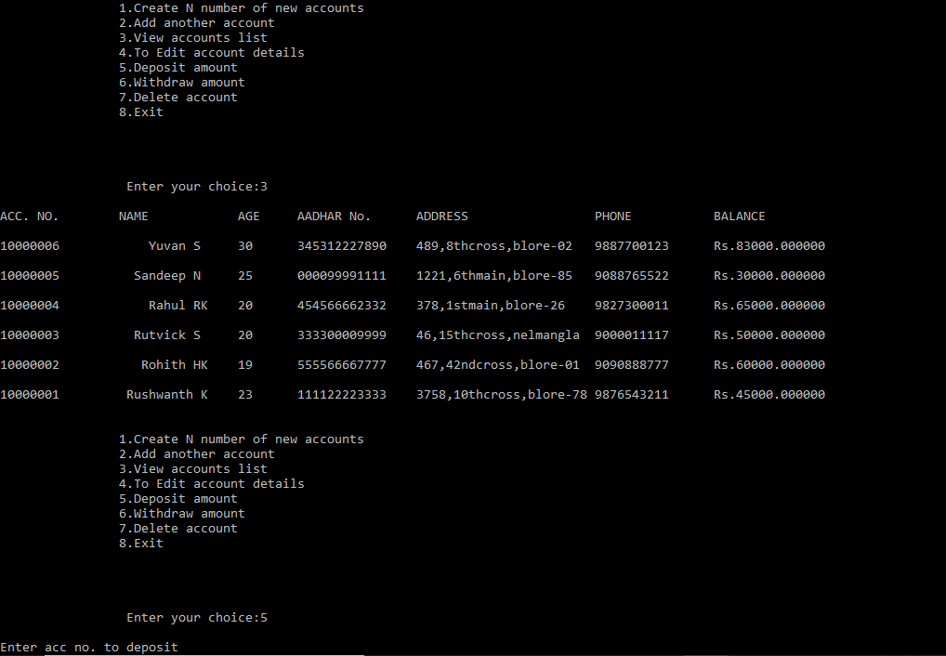
Department of ISE,RNSIT

Slide 30
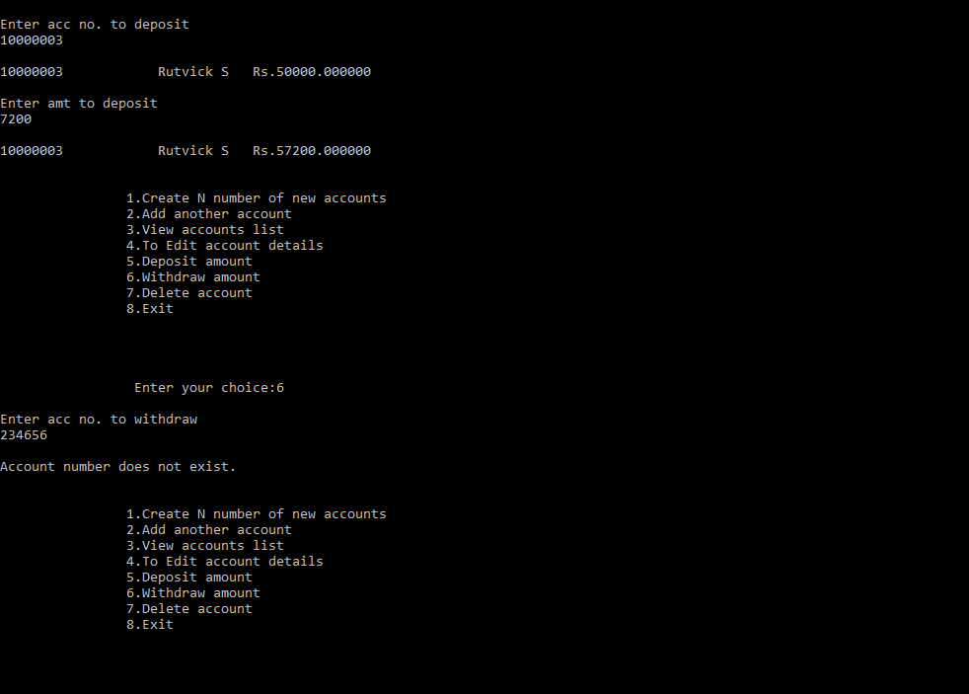
Department of ISE,RNSIT

Slide 31
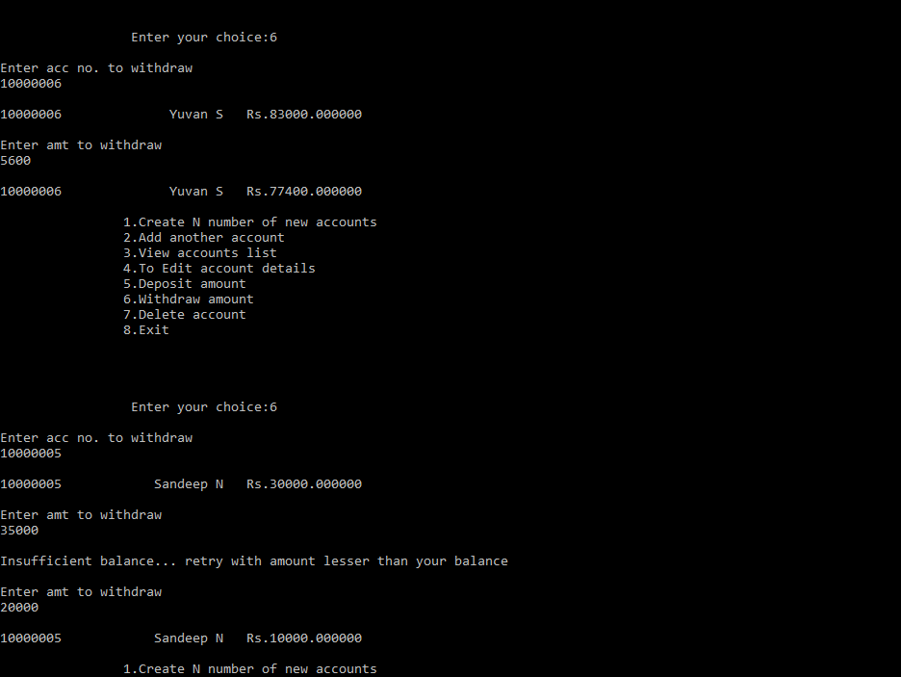
Department of ISE,RNSIT

Slide 32
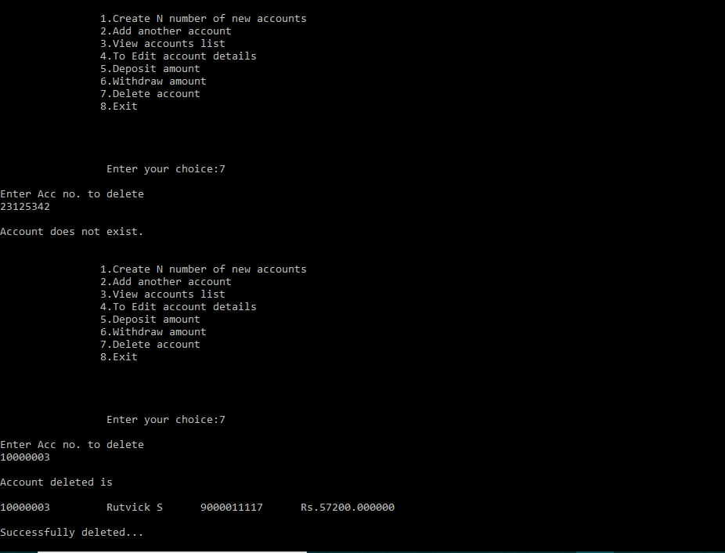
Department of ISE,RNSIT

Slide 33
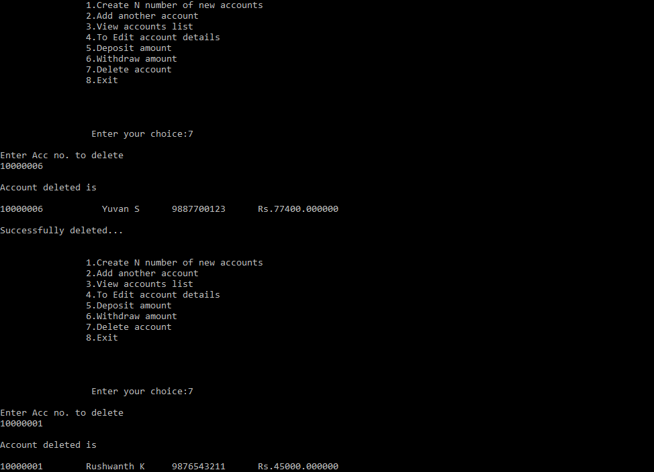
Department of ISE,RNSIT

Slide 34
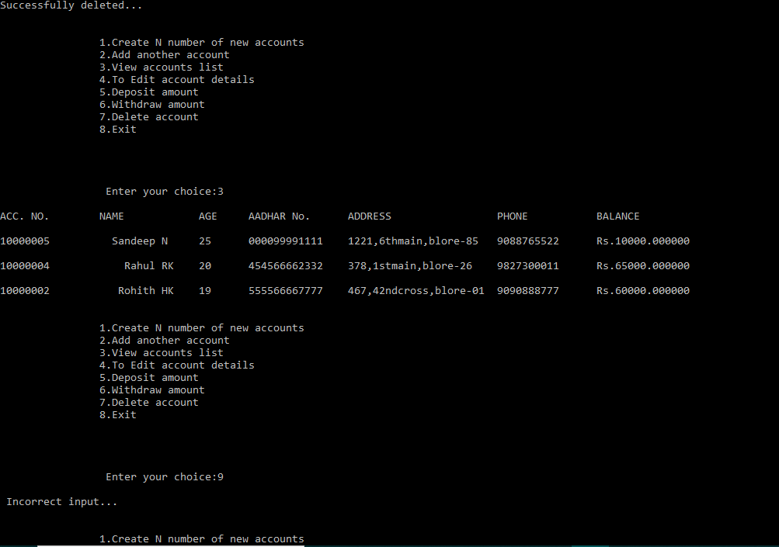
Department of ISE,RNSIT

Slide 35
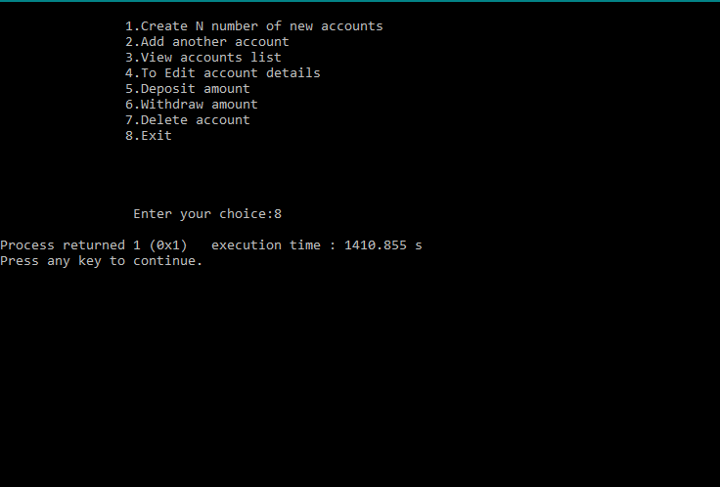
Department of ISE,RNSIT

Slide 36
This banking system project will serve as a useful approach to data base dialog box to deposit and withdraw the money for the person. It will reduce the time taken by the user/admin to handle accounts. This program has a user friendly approach.
Currently handling savings account only in future we can handle other types of account ex:-Fixed deposit, retirement accounts, checking accounts, etc. And even online banking will be updated soon. Passwords and log-in Id’s will be added for better security and privacy.
Department of ISE,RNSIT

Slide 37
Books- ‘Programming in C & Data Structures’ by A.A Godse
Weblinks- https://www.codewithc.com/mini-project-in-c-bank-management-system/
Department of ISE,RNSIT

Slide 38

Department of ISE,RNSIT

